Slide 1

ANNA NEKHA SHABU C0726583
BALJOT C0728612
LAKSHMI PRIYA C0732069

Slide 2
SPRINT 1 : 20 Feb – 24 Feb | SPRINT 2: 25 Feb – 28 Feb | SPRINT 3: 1 Mar – 4 Mar | SPRINT 4: 5 Mar – 7 Mar
1. Splash Screen | 1. Coding Screens | 1. Location Accessing and design | 1. Support, Logout
2. Login Page | 2. Home Menu | 2. Parking Report | 2. Coding screens
3. Registration Page | 3. Parking Manual | 3. Payment Receipt | 3. Validation
4. Home Page Design | 4. Validation | 4. Conversion to PDF | 4. Remaining coding, screen Design
5. Review Designing | 5. Review Coding | 5. Review Coding & Validation | 5. Review Coding & Validation

Slide 3
introduction
24 X 7 Parking system is used to help manage parking area in order to avoid congestion, safe parking, time conservation.
Our application reads user data and let’s user to login.
He can choose a particular area for parking for a particular period of time and later he can generate his payment receipt.
Also can view all the parkings done so far.

Slide 4
System overview
Our application is user friendly.
This system identifies priority parking user and allots the space to park the car.
Identifies parking areas for users.
It offers unique facilities, benefits and advantages by saving time and energy.
It requires lower maintenance and services and ensures efficient functioning and co-ordination within the parking space.

Slide 5
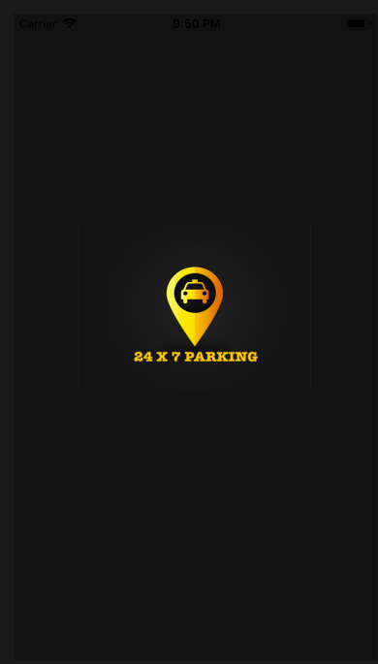
SPLASH screen
Loads 24 X 7 parking with its logo.

Slide 6
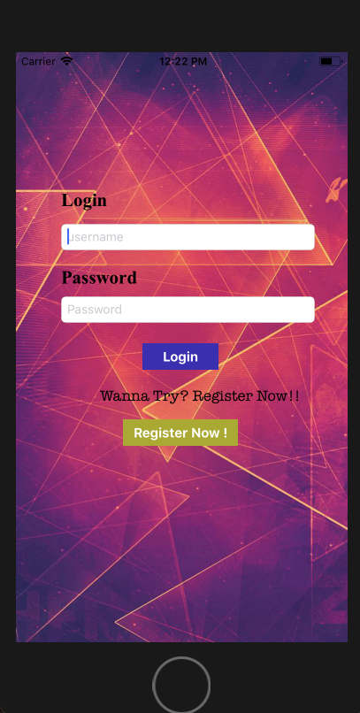
LOGIN
Login screen allows registered users to login using username and password.
Also lets new users to register.

Slide 7
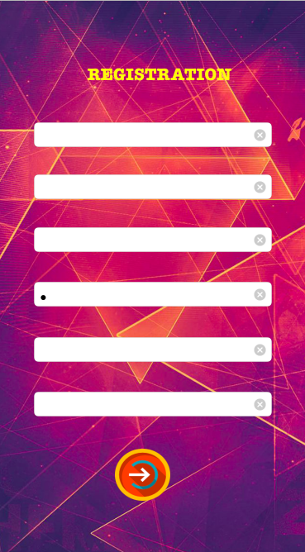
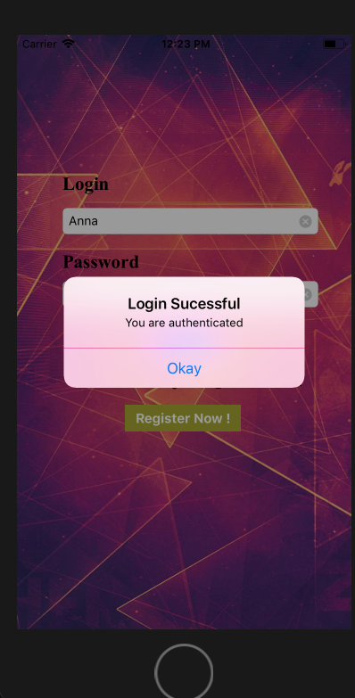
Registration
New users can register with their first and last names, email id, password, contact number, Car plate number.
An alert will be generated on successful registration and data will be saved.
Then the user can login using his username and password.

Slide 8
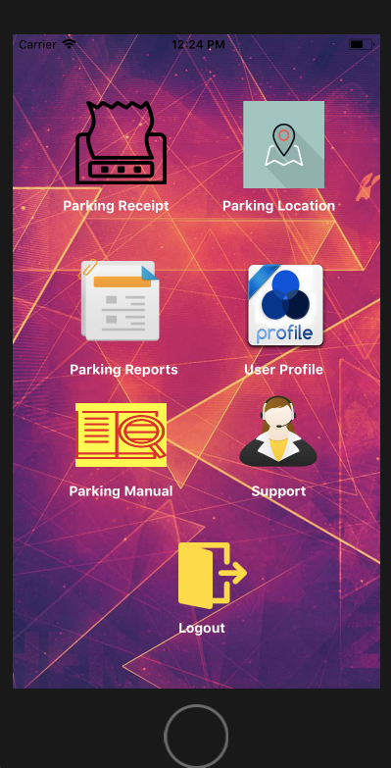
Home
Contains the main menus
Parking Receipt
Parking Location
Parking Reports
User Profile
Parking Manual
Support
Logout

Slide 9
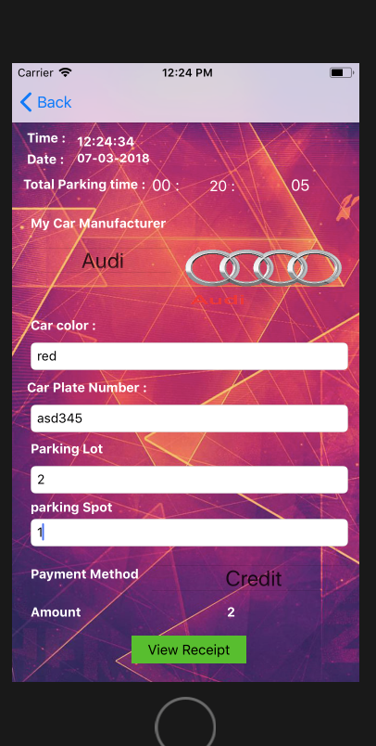
Parking Receipt
PAYMENT RECEIPT READS
Time
Date
Total Parking Time
Car Manufacturer
Car Color
Car Plate Number
Parking lot
Parking Spot
Payment Method
Amount
ON CLICKING VIEW RECEIPT BUTTON IT SHOWS THE RECEIPT.

Slide 10
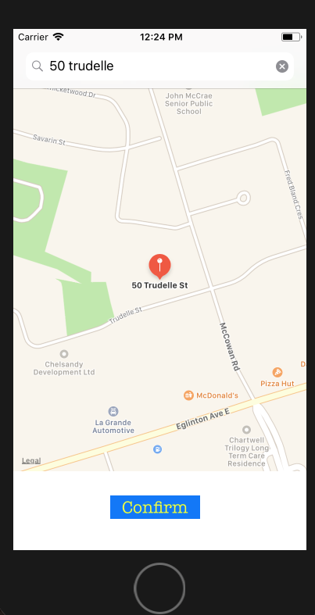
Parking location
Search for location to park.
User can park in that location.

Slide 11
Parking report
This generates the parking reports of all the parkings done so far.
This makes it convenient for the user to identify all the parkings he had done so far.

Slide 12
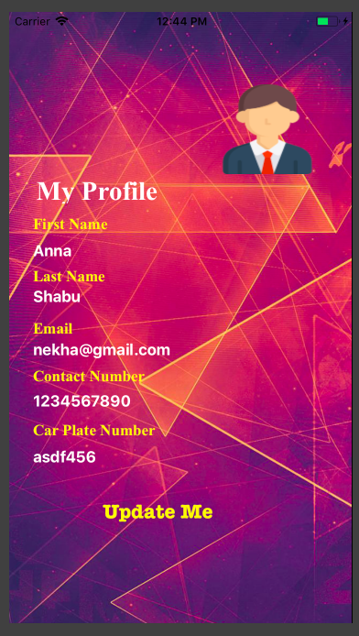
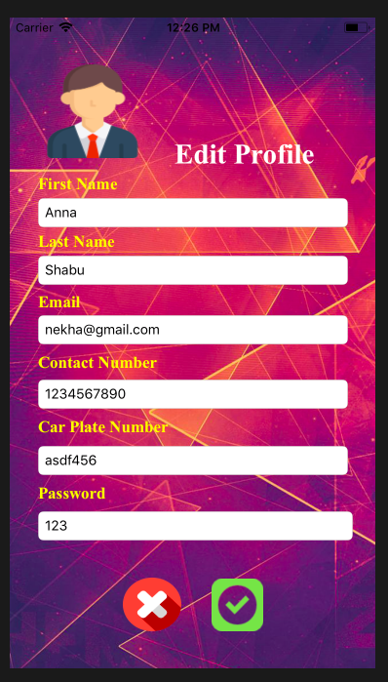
User profile
Shows the Profile Info which is registered of the user :
First Name
Last Name
Email
Contact Number
Car Plate Number
The user can also edit his profile if he/she wishes to.

Slide 13
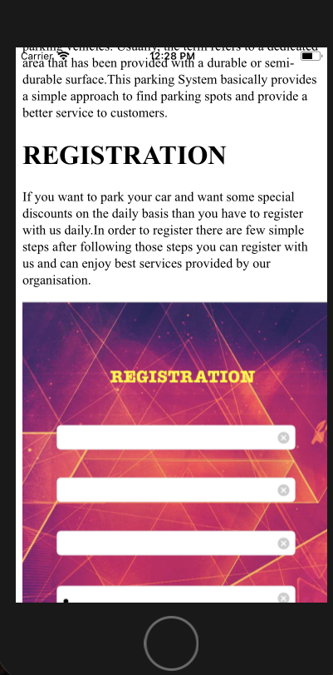
Parking manual
Displays Information about the 24 X 7.
Explains the features and functionalities offered.
Also gives user step by step description about all the menus.

Slide 14

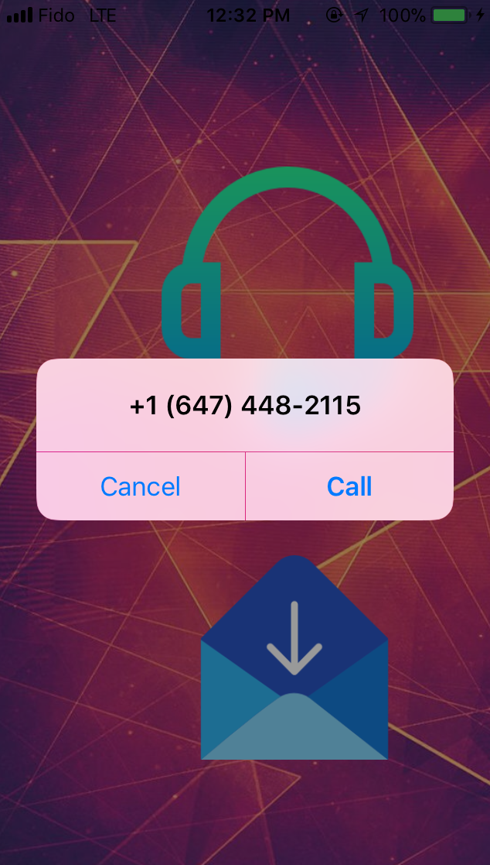
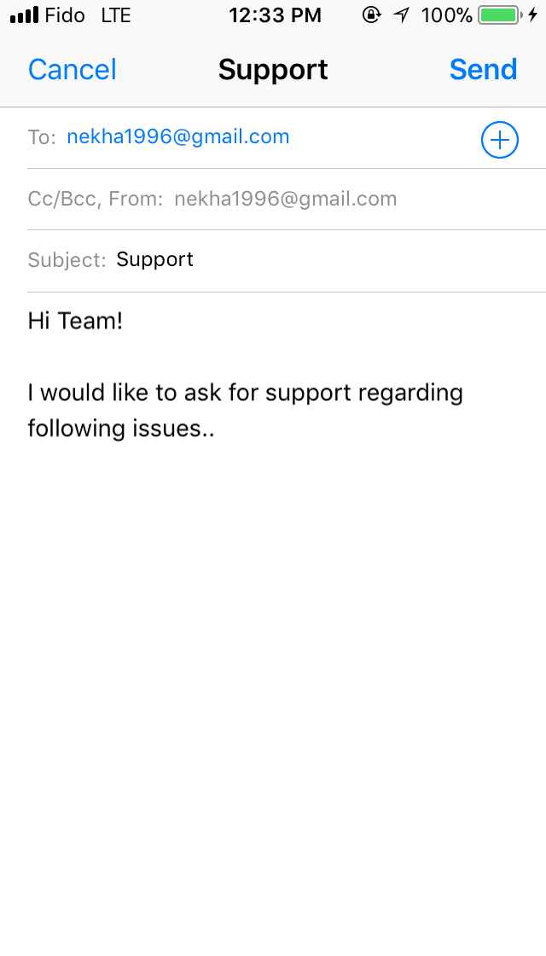
Support
For any support, user can contact or mail us.
User’s can directly contact our customer service or can send us a mail.
We are happy to help.

Slide 15
SPRINT 1 : 20 Feb – 24 Feb | SPRINT 2: 25 Feb – 28 Feb | SPRINT 3: 1 Mar – 4 Mar | SPRINT 4: 5 Mar – 7 Mar
1. Splash Screen | 1. Coding Screens | 1. Location Accessing and design | 1. Support, Logout
2. Login Page | 2. Home Menu | 2. Parking Report | 2. Coding screens
3. Registration Page | 3. Parking Manual | 3. Payment Receipt | 3. Validation
4. Home Page Design | 4. Validation | 4. Conversion to PDF | 4. Remaining coding, screen Design
5. Review Designing | 5. Review Coding | 5. Review Coding & Validation | 5. Review Coding & Validation
 |  |  | 6.Parking Report

Slide 16
THANK YOU…

